Slide 1
INTRODUCTION TO PYTHON

Slide 2
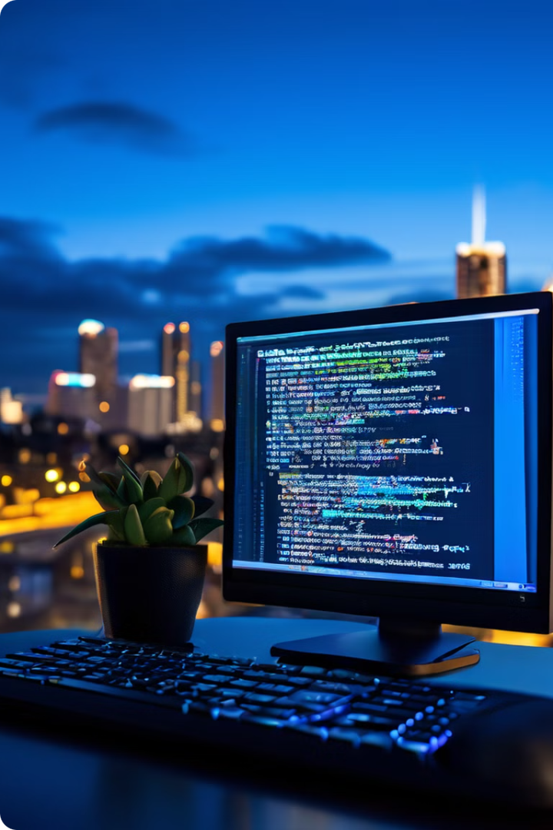
Introduction to Python
Python is a high-level programming language known for its readability, simplicity and ease of use.
It has gained popularity in various domains, including: -
Web development
Data science
Machine learning
Scripting.

Slide 3

What is Python?
High-Level Language
Interpreted Language
Object-Oriented Language
Python is a high-level language that focuses on readability and abstraction, making it easier for programmers to understand and write code.
Python code is executed line by line by an interpreter, without the need for compilation, making it faster for development and prototyping.
Python supports object-oriented programming principles, allowing programmers to organize code into reusable objects, enhancing code modularity and maintainability.

Slide 4
History and Development of Python
1989
1
Python was conceived by Guido Van Rossum in the Netherlands.
2
1991
The first version of Python was released, named after the British comedy group Monty Python.
2000s
3
Python gained momentum with the rise of web development and scripting tasks.
4
2010s
Python became dominant in data science, machine learning, and artificial intelligence.
Present
5
Python continues to evolve with new features and libraries, expanding its reach and impact.

Slide 5
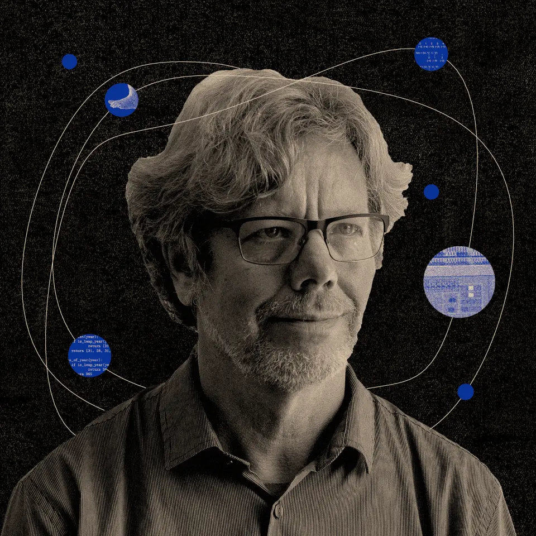
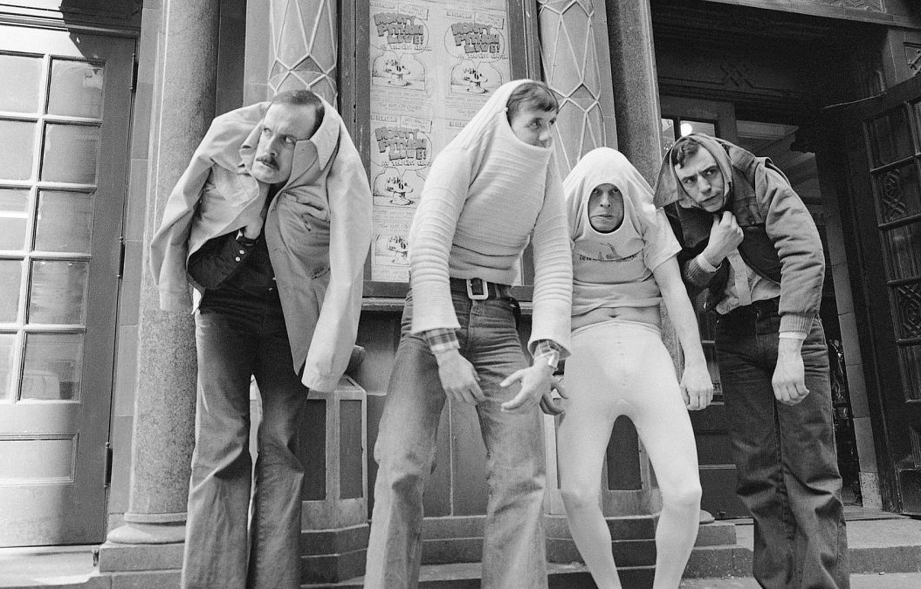
History and Development of Python
Guido Van Rossum
Monty Python Show

Slide 6
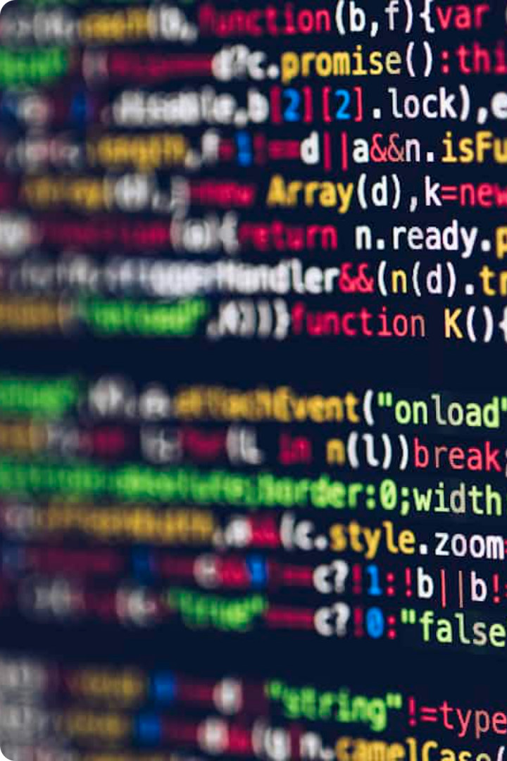
Key Features of Python
1
Readability
2
Extensive Libraries
Python's clear and concise syntax makes it easy to understand and write code.
Python has a vast collection of libraries and modules that provide pre-built functionality for various tasks.
3
Cross-Platform Compatibility
4
Strong Community Support
Python can run on different operating systems, making it highly portable and accessible.
Python has a large and active community of developers who contribute to its growth and provide support.

Slide 7
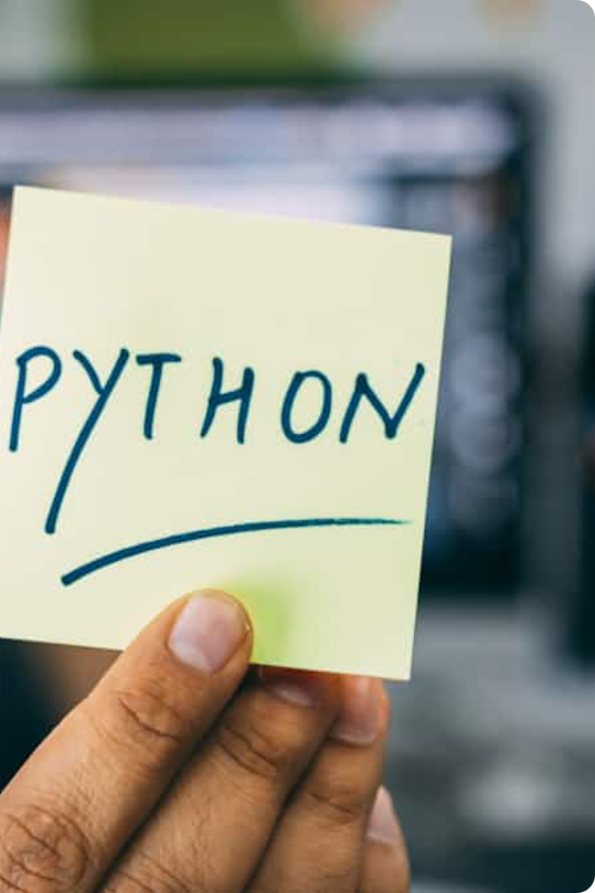
Python Syntax and Coding Conventions
Indentation
Keywords
Comments
Python uses indentation to define blocks of code. Whitespace is significant and enforces code readability.
Python has reserved words with specific meanings, such as "if," "else," "for," and "while," which control the flow of execution.
Comments are used to explain code and improve readability. They are ignored by the interpreter and start with the "#" symbol.

Slide 8

Python Data Types and Variables
Data Type
Description
Example
Integer (int)
Whole numbers without decimal points.
10, 25, -5
Float (float)
Numbers with decimal points.
3.14, 1.5, -2.0
String (str)
Sequences of characters enclosed in quotes.
"Hello", "World"
Boolean (bool)
Represents truth values (True or False).
True, False
List (list)
Ordered collections of items enclosed in square brackets.
[1, 2, 3], ["apple", "banana"]

Slide 9
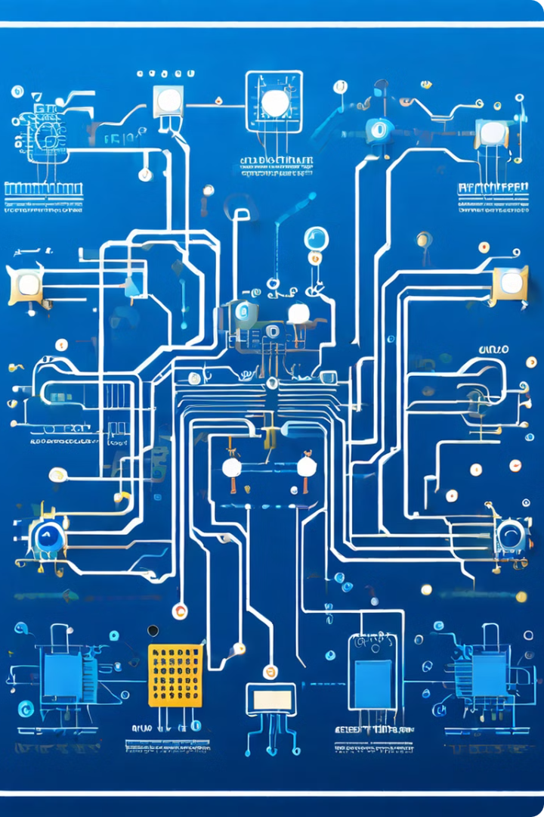
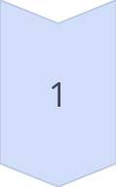
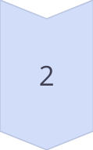
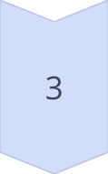
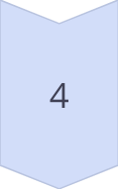
Python Operators and Expressions
Arithmetic Operators
Used for mathematical calculations.
Comparison Operators
Used to compare values and return True or False.
Logical Operators
Used to combine Boolean expressions.
Assignment Operators
Used to assign values to variables.

Slide 10
Python Control Structures
Conditional Statements
Loops
Allow code to execute different blocks based on conditions (if, elif, else).
Repeat blocks of code multiple times (for, while).

Slide 11

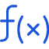


Python Functions and Modules
Functions
Reusable blocks of code that perform specific tasks.
Modules
Collections of functions and classes that provide pre-built functionality.
Packages
Collections of modules that organize related functionality.

Slide 12

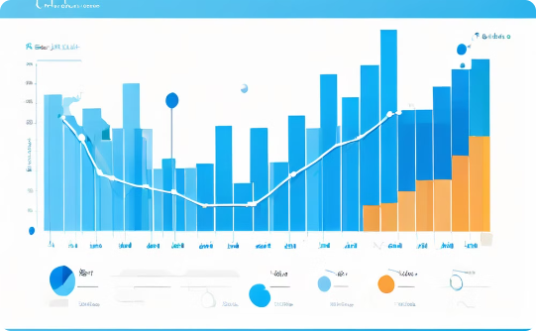
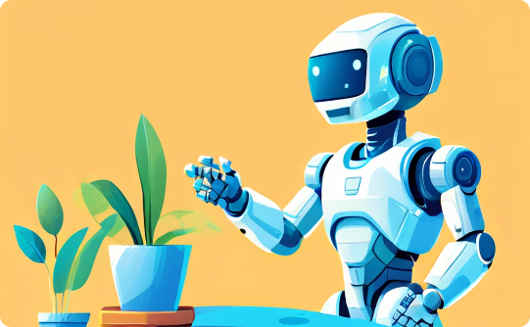
Python Applications and Use Cases
Web Development
Data Science
Artificial Intelligence
Python is used for back-end development, creating web applications, APIs, and frameworks.
Python is widely used for data analysis, manipulation, visualization, and machine learning.
Python is a leading language for developing AI applications, machine learning algorithms, and deep learning models.

Slide 13
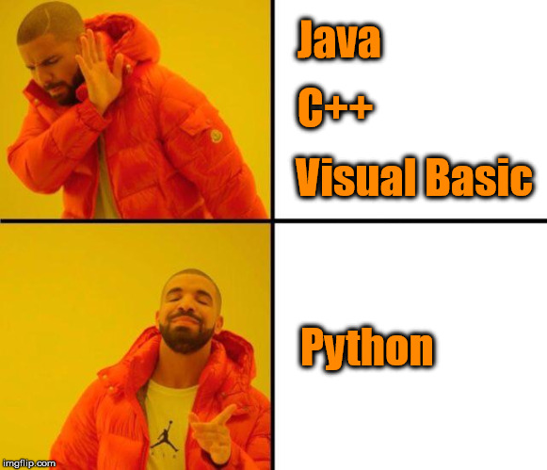
Practical
So let’s Install of Python 3

